Slide 1
Chapter 1: Studying the State of Our Earth

Slide 2
What exactly are we going to study?
What is the environment?
What is environmentalism?
?

Slide 3
Envi. Science
Envi. Studies
-
-
-
-
-
-
-
-
-
-
-
-
-
-
-
-
See fig 1.1, pg 3

Slide 4
Humans Alter the Environment
How have we altered the environment?
The question is not if we are altering the environment but if we are degrading it.
What is the difference?
The environment has been degraded if it……

Slide 5
Environmental Services
Pair and Share:
Forests
Oceans
Wetlands
Earthworms and Fungi
To know if we are degrading the environment, we must monitor it. How do you monitor your health?
Environmental indicators ……

Slide 6
Environmental Indicators of Stress, pg 4-11
Biological Diversity
a.
b.
c.
Food Production
Average Global Surface Temperature & CO₂ concentrations
Human Population
Resource Depletion
Notes:
1b. Background extinction rate—1 species per million every year unless a catastrophe. We have identified 2 million species. The estimated current extinction rate is 10,000 per year or 5,000 the normal extinction rate.
Food production has grown steadily since the 1950’s, but per capita it has not.
Is it anthropogenic? Is it because of humans
Human population is expected to be 8.1 to 9.6 billion in 2050 and stabilize between 6.8 to 10.5 billion by 2100
Nonrenewable resource examples: coal, oil, natural gas. People in developed countries consume 85% of worlds resources.

Slide 7
What is a hectare (ha)?, pg 7
Measurement of land area like a square mile or acre. How many acres are in 1 ha?
1 mi² = 640 acres
1 km = 0.6214 mi
100 ha = 1 km²
Can you solve this using dimensional analysis?

Slide 8
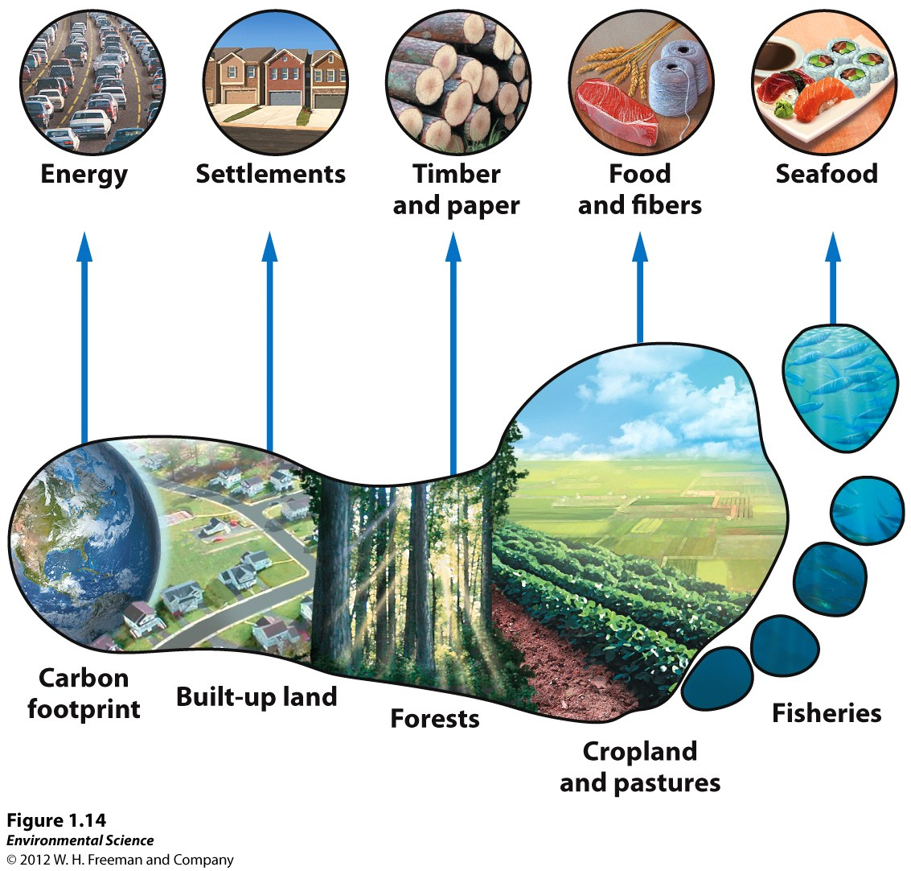
Ecological Footprint, pg 13
William Rees and Mathis Wackernagel, 1995
-
-
See fig 1.14 pg 15
Homework: use a website
to find your ecological foot-
print. Print out a page or
take a screen shot as proof.

Slide 9
Tragedy of the Commons
Fishing in a common “pond”.
Ponds start with 10 fish. Everyone starts with one straw for “fishing” and $10.
Each round is 30-45 seconds. You live if you get one fish. You can sell fish for $5.
For every fish left at the end of the round reproduces one fish.
Discussion.

Slide 10
Sustainability
Living in a way so that crucial human activities could continue indefinitely.
Were your fishing practices sustainable?
Sustainable requirements include:
-
-
-

Slide 11
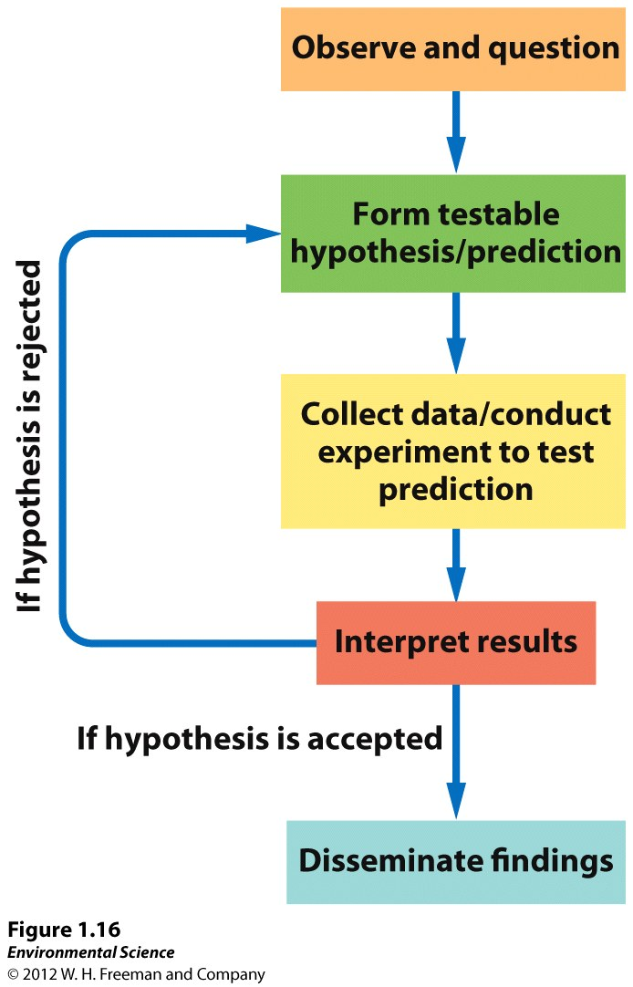
The Scientific Method
Observations and questions
Hypothesis
Collecting data
-sample size
-accuracy, precision
-uncertainty
Interpreting results
Disseminating findings

Slide 13
Chp 2: Environmental Systems

Slide 14
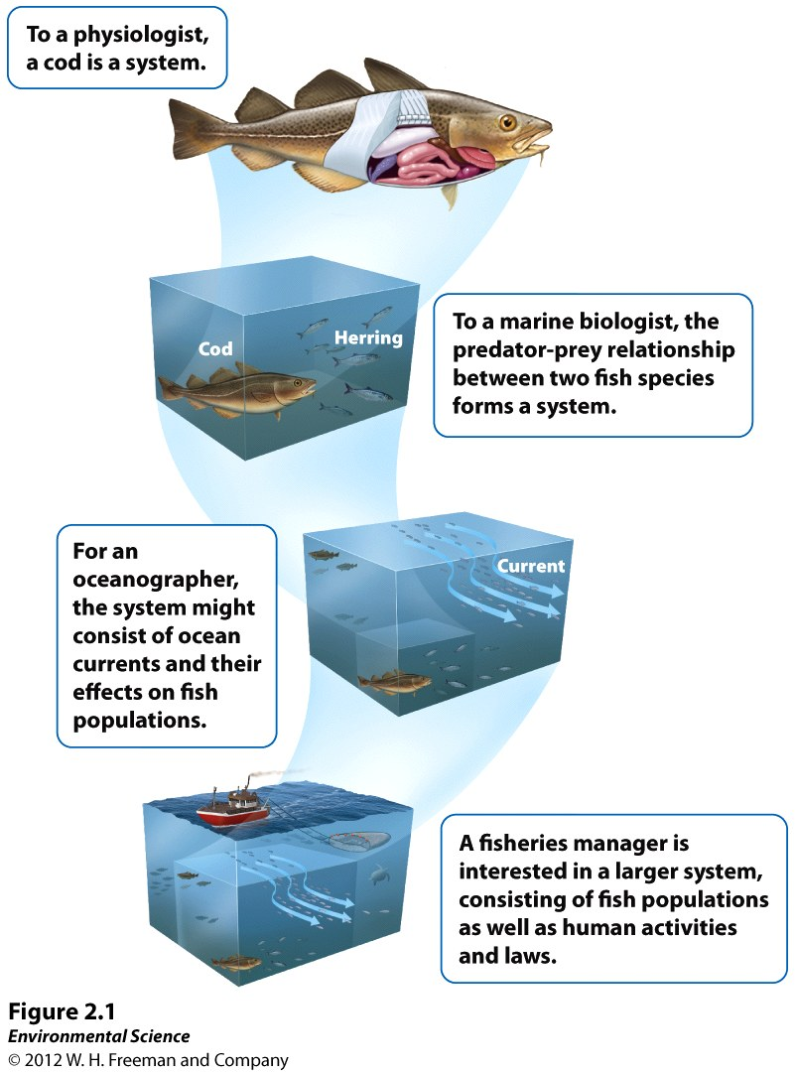
Earth is an Interconnected System
Systems are parts that interact with each other.
Systems can be open or closed in regards to both matter and energy.
Notes:
What are the different levels of a system? cell up to earth. We will primarily be looking at the larger systems.

Slide 15
All environmental systems consist of matter.
Matter
Atom
Compound
Molecule
Isotope
Radioactive decay
Half-life

Slide 16
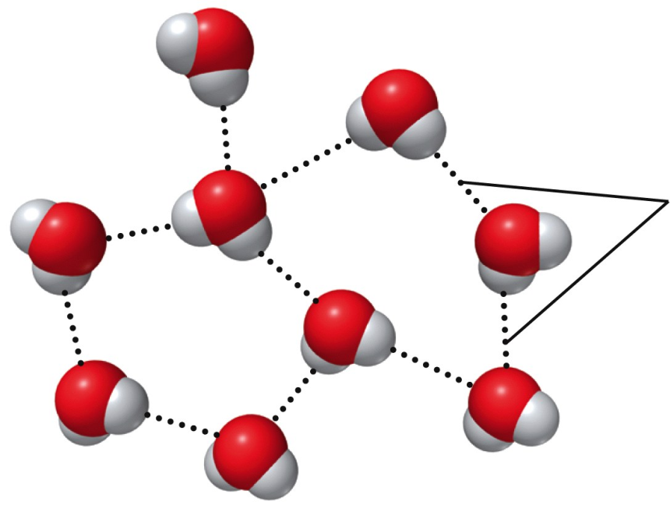
Atoms interact forming bonds.
Ionic Bond
Covalent Bond
Hydrogen Bond

Slide 17
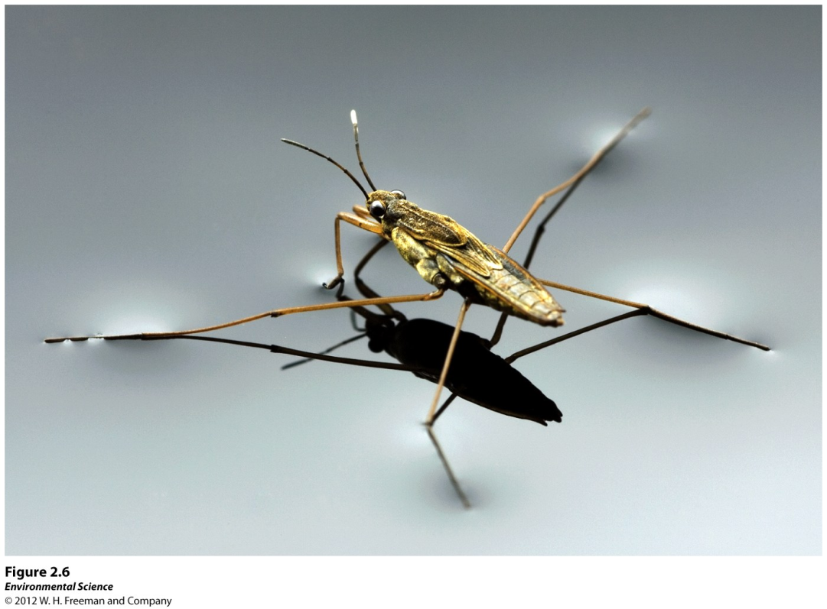
Properties of Water
1. Surface tension-
2. Capillary action-

Slide 18
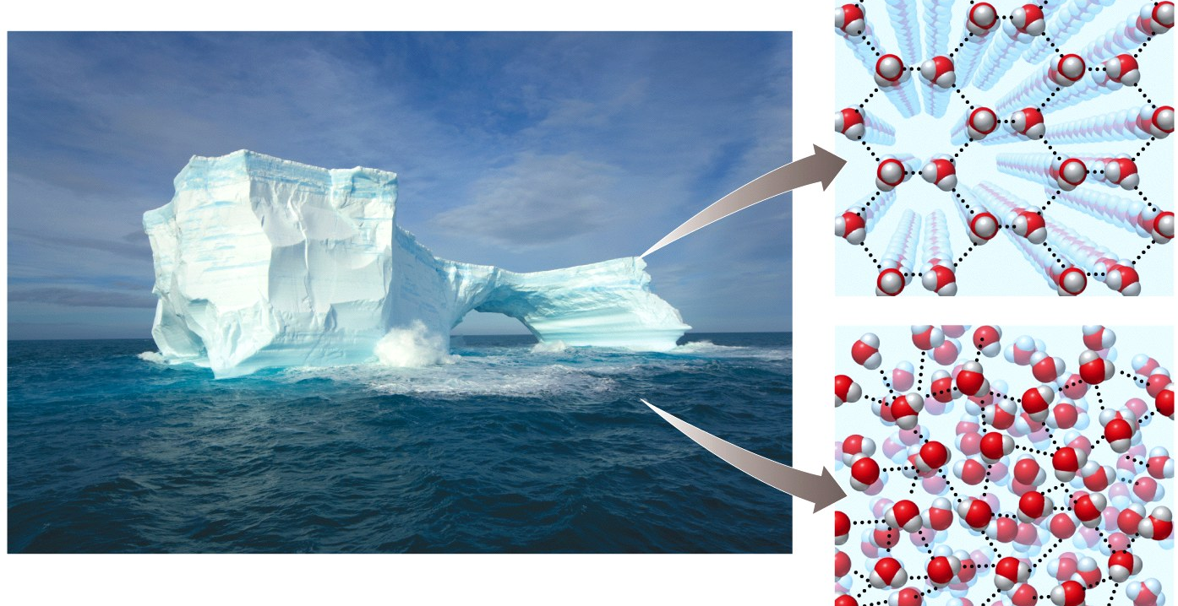
3. Boiling and freezing-
4. Water as a solvent-

Slide 19
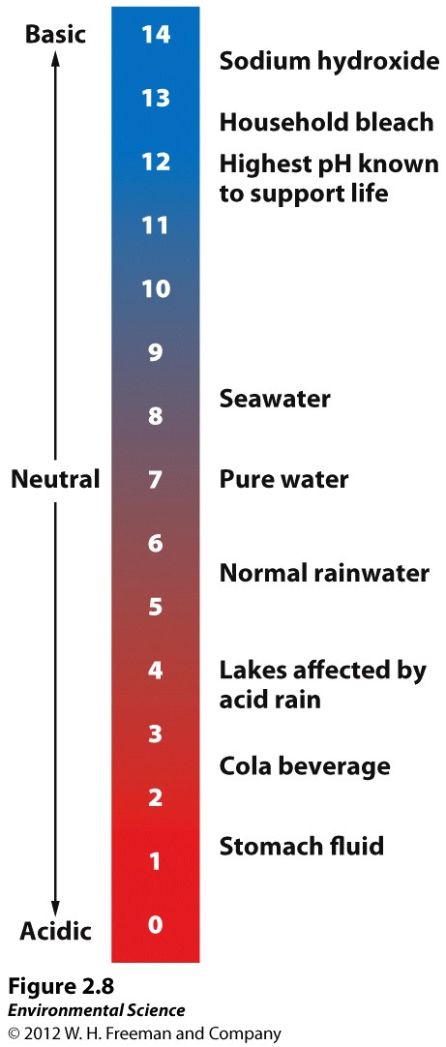
acids, bases, and pH
pH- a way to indicate the strength of acids and bases.
Range of scale is…
A pH value of 7 is …
A pH above 7 is …
A pH below 7 is ….

Slide 20
“Classes” of Chemistry
1. Inorganic compounds- compounds that do not contain carbon or do contain carbon, but only carbon bound to elements other than hydrogen.
ex. NH₃, NaCl, H₂O, and CO₂
2. Organic compounds- compounds that have carbon-carbon and carbon-hydrogen bonds.

Slide 21
Types of Biomolecules
1. Carbohydrates- compounds composed of carbon, hydrogen,and oxygen atoms. Ex. C6H12O6
2. Proteins- made up of long chains of nitrogen-containing organic molecules called amino acids.
3. Nucleic Acids- organic compounds found in all living cells.
DNA
RNA
4. Lipids- smaller biological molecules that do not mix with water. Ex. fats, waxes and steroids.

Slide 22
Energy
Energy- the ability to do work; unit is the _____ or ________
Forms of Energy classification activity
Kinetic—energy of motion
Potential—energy that is stored

Slide 23
Power- the rate at which work is done; unit is ______ What are the units for the energy that you use in your home?

Slide 24
Do the Math, pg 38
Let’s work through this example in class.

Slide 25
Laws of Thermodynamics
First Law-
-example:
Second Law–
-example:

Slide 26
Energy efficiency/quality
Energy efficiency---ratio of work performed per energy put in
Explain energy efficient appliances
Energy Quality– the ease with which an energy source can be used for work
What fuel is used to power automobiles? Why not wood? Why not jet fuel?

Slide 27
Math Practice
Half sheet handed out in class to practice conversions and energy quality comparisons.
Remember to use units and to use dimensional analysis to help with conversions.

Slide 28
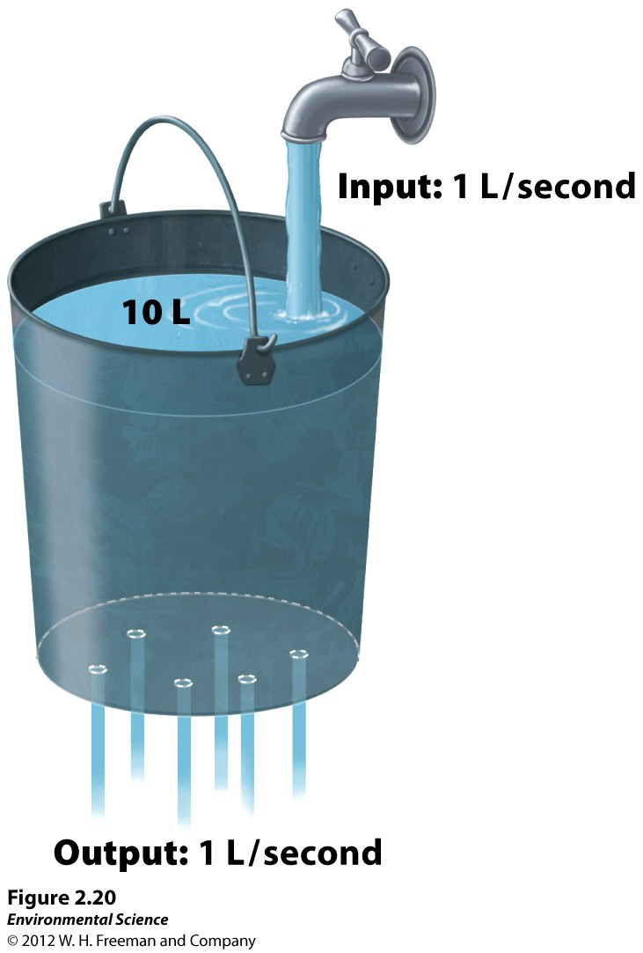
Systems Analysis
Give an example of/define:
Open
Closed
Input
Output
Steady state

Slide 29
Feedbacks
-the result of a process feeds back into the system to change the rate of the process
Positive feedback loop—the result of a process __________ the change
Negative feedback loop—the result of a process __________ the change
Labor and contractions
Sweating

