Slide 1
Chp 3: Ecosystem Ecology

Slide 2
Ecosystem Boundaries
Boundaries can be well defined (example: __) or they can be subjective (example: ____ ).
Boundaries:
  can cross borders of states or countries
  can be vast (pg 59)
  can be “micro”

Slide 3
Energy Flow in Ecosystems
Photosynthesis and Respiration
Trophic Levels
Food Chains
Food Webs

Slide 4
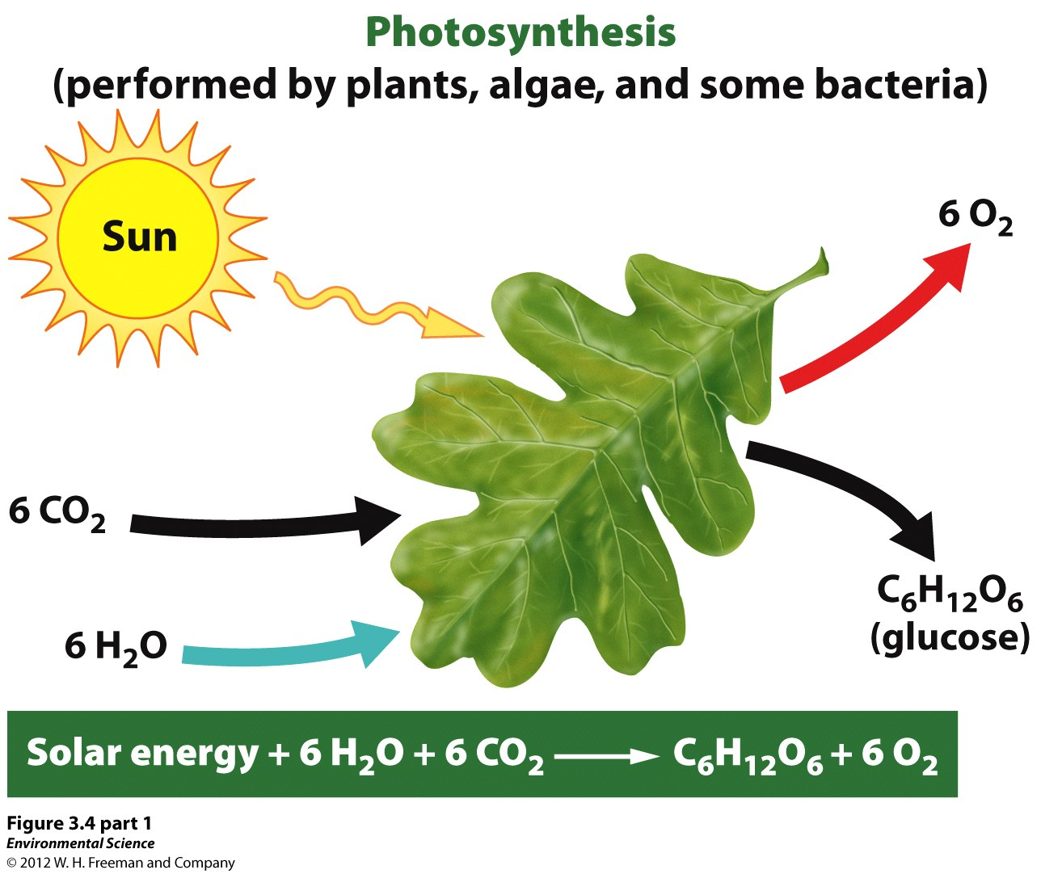
1a)Photosynthesis, pg 61

Slide 5
Law of conservation of mass upheld?
Organisms that undergo photosynthesis are _______________________. They are the foundation of all food webs and chains.
Examples:
  terrestrial---
  aquatic---
Notes:
Examples: plants, algae, bacteria, phytoplankton

Slide 6
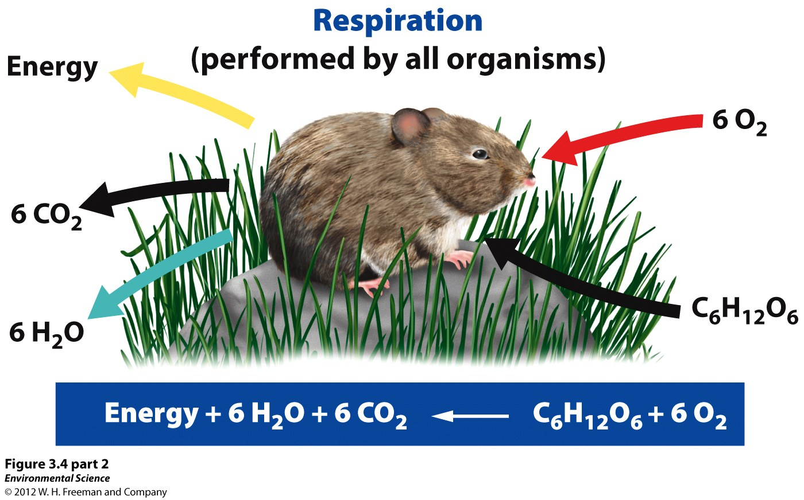
1b) Cellular Respiration

Slide 7
Law of conservation of mass upheld?
All organisms must use energy to carry out life functions. ________ organisms undergo respiration.
What will happen if more cellular respiration than photosynthesis occurs?

Slide 8
2. Trophic Levels
Organisms that can only get energy by consuming other organisms are____________ or _________________.
Consumers can further be categorized: herbivore, omnivore, carnivore.
  Examples of each:

Slide 9
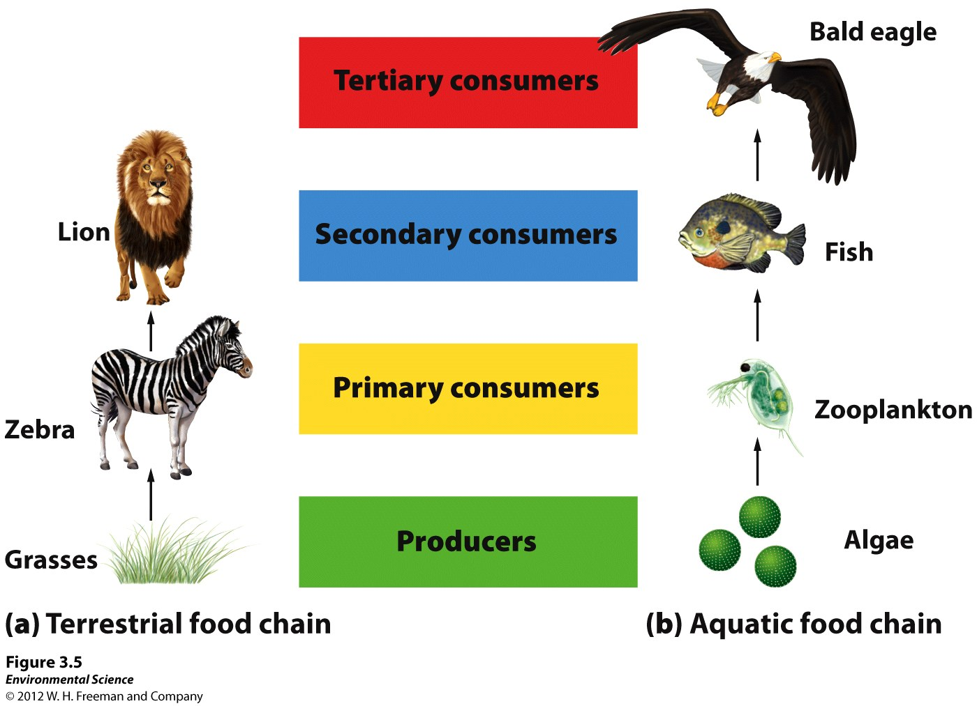

Slide 10
These successive levels of organisms consuming one another are ____________.
Energy moves up the trophic levels, but usually only ___% gets transferred. Where does it go?
Another way to show how energy moves from one organism to another is a _____________.
_____________are more realistic. Why?
In both, the arrows point towards _____________.

Slide 11
Some organisms don’t fit so neatly into a trophic level.
  _____________ eat dead organisms and can be at any level.
  _____________ break down dead tissue.
  _____________ breakdown nutrients and do the final recycling.

Slide 12
Ecosystem Productivity
Since most energy enters an ecosystem through autotrophs, they determine how much life can be supported by that ecosystem.
The ____________________ is how much solar energy the producers in an ecosystem capture in a given year.
The unit is kcal/m²/yr.
Notes:
The more energy an ecosystem has, the more life it can support. Where does most of the energy enter an ecosystem?

Slide 13
What does “gross” mean? Why is this not a true reflection of the energy available to the next level?
_______________takes into account that autotrophs undergo cellular respiration.
NPP = GPP – respiration by producers
Only the ____________ (dry organic material) represented by the NPP is available as nutrients to the next trophic level.

Slide 14
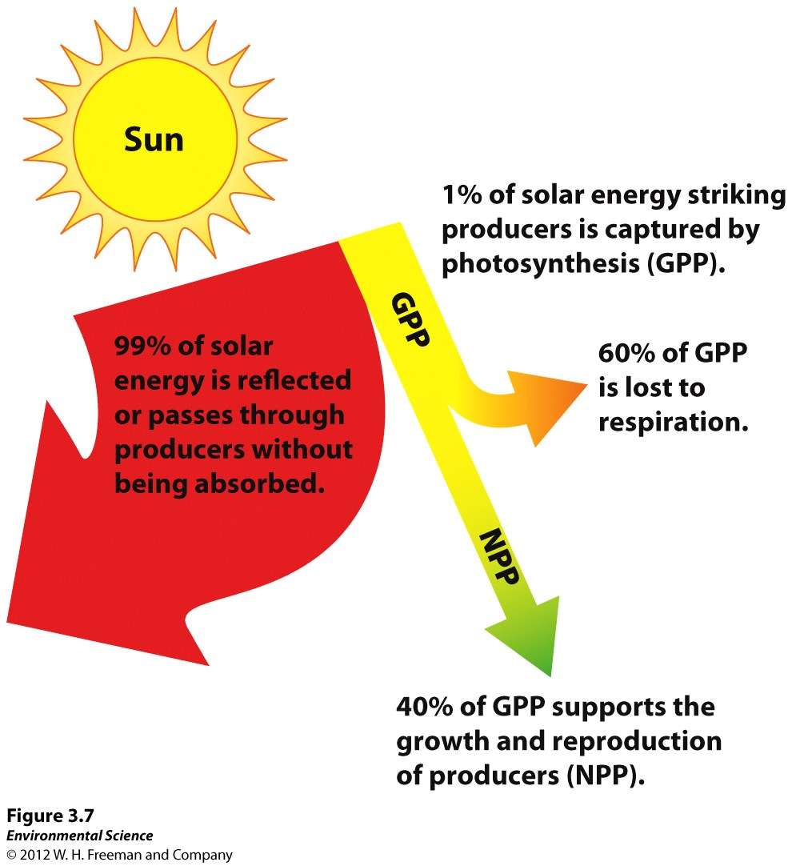

Slide 15
Trophic Pyramids
How does the 2nd law of thermodynamics affect the amount and quality of energy available to each successive trophic level?
It is a general assumption that only 10% of energy available at one level makes it to the next.
Actual _______________can range from 5% to 20%.

Slide 16
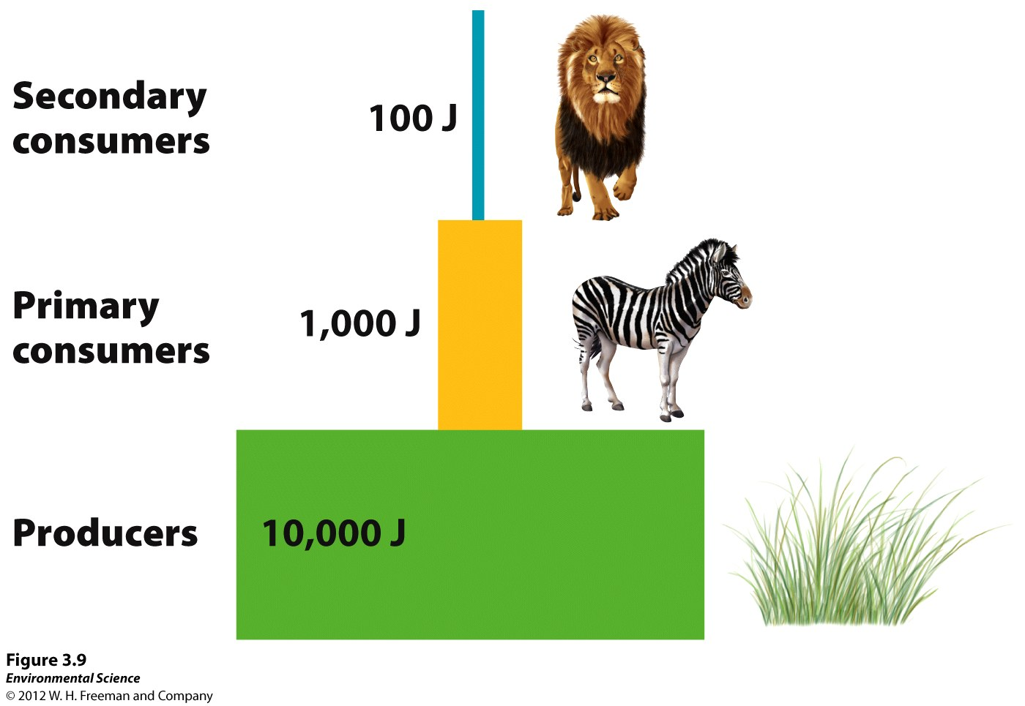

Slide 17
Read the last two paragraphs on pg 65.
How is the notion that “vegetarians are better for the environment” supported by ecological efficiency?

Slide 18
Matter Cycling in an Ecosystem:
Biogeochemical Cycles
Use pages 66 to 73 to complete the Biogeochemical Cycles Organizer

Slide 19
Long-term Carbon Storage
Sleipner Field
http://www.amnh.org/explore/science-bulletins/(watch)/earth/documentaries/storing-co2-to-protect-the-climate
Shell video
http://www.youtube.com/watch?v=cohgQZq-l1w

Slide 20
Ecosystem Response to Disturbance
A _________ is an event that causes a change in population size or community composition.
  natural and anthropogenic examples
  short-term and long-term examples
  Are all disturbances disasters?

Slide 21
Resistance and Resilience
______________
  Measure of how much a disturbance affects the flow of energy and matter
  High resistance or low resistance depends on if the net primary productivity is affected. (wildfires)
______________
  Rate at which an ecosystem returns to its original state
These ideas refer to flows of energy and matter and not necessarily species numbers.

Slide 22
_________________________
Disturbances are a natural part of life.
Ecosystems experiencing intermediate levels of disturbance are usually the most _______________.
Pg 76, fig 3.19

Slide 23
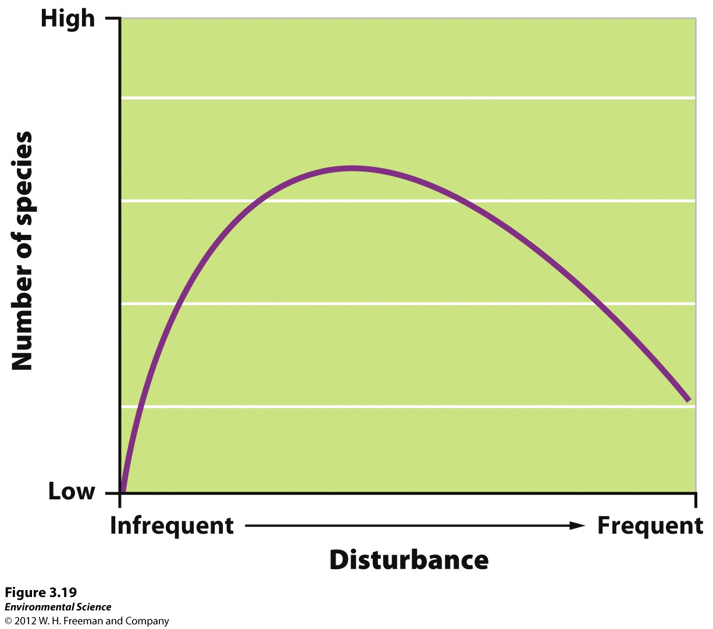

Slide 24
Ecosystem Services
__________________—ecosystem worth because it is useful as an instrument or tool
  _________ (goods)
  ___________________ -production of oxygen; fixing of nitrogen
  Support systems- filtering water; pollination of food crops; natural pest control; habitat for animals
  ______________ research; gain knowledge; beauty

