Slide 1
Chapter 4: Global Climates and Biomes

Slide 2
Global Processes that Determine Climate
Atmosphere
a. Composition
b. Unequal heating
c. Convection Currents
d. Coriolis Effect
2. Earth’s Tilt
3. Ocean Currents
Gyres
Thermohaline circulation

Slide 3
1a. Atmosphere Composition
Component | Symbol | Percentage
Nitrogen | N₂
Oxygen | O₂
Argon | Ar
Carbon Dioxide | CO₂
Other
Water | H₂O
Bonus: What was the earth’s earliest atmospheric composition?
Notes:
Nitrogen- dilutes oxygen so we don’t have uncontrolled burning; need for building protein and DNA
Oxygen- for respiration and combustion
Argon- used in light bulbs
Carbon Dioxide- used by plants for photosynthesis; traps heat that allows earth to regulate its temperature
Water: where is the lowest percentage of water in the air? Where is the highest? How does the change in water percentage change the other percentages?

Slide 4
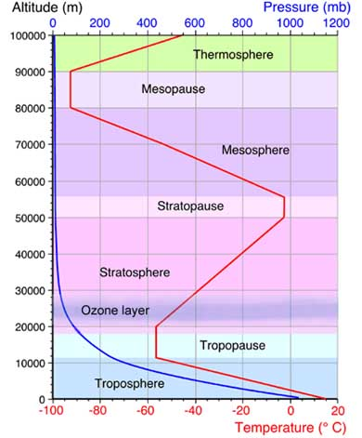
Layers
Five distinct layers have been identified using...thermal characteristics (temperature changes), chemical composition, movement, and density.
Notes:
Predict: How does the temperature change? How will the composition change? What is meant by movement? Density?

Slide 5
1. Troposphere
___________miles (6-20 km) high (thicker at equator and thinner at poles)
62°F (17°C) to -60°F (-51°C)
-____________________________
2. Stratosphere
up to _________miles
Temperature rises from an average -76°F (-60°C) at tropopause to a maximum of about 5°F (-15°C) because absorbs UV radiation.
- _____________________

Slide 6
3. Mesosphere
Up to about ______miles (85 km)
Temperature decreases from about 5°F (-15°C) to as low as -184°F (-120°C).
Friction with meteorites causes_____________________________
4. Thermosphere
Up to 430 miles (690 km)
Temperature ___________with height because of UV and x-ray radiation absorption and can reach as high as 3,600°F (2,000°C).
-_________________________________

Slide 7
5. Exosphere
-Up to 6,200 miles (10,000 km)
- “outer space” with satellites orbiting
“6” Ionosphere
From 37 to 190 miles (60-300 km) (upper mesosphere and lower thermosphere)
UV and other radiation (from the sun), which causes temperatures to rise in the thermosphere, creates this layer. So, its density changes from day to night.
Reflects radio waves and makes it possible for communication by radio.

Slide 8
1b. Unequal Heating
_________________________
Some energy is lost because of distance energy travels through atmosphere.
2. Surface area that rays hit
At larger angles, the area the energy hits is larger making it not as effective at heating
See fig 4.3, pg 90
3. Some areas reflect more than others. This is called ______________.
See fig 4.4, pg 90

Slide 9
1c. Convection Currents
Four properties of air, along with unequal heating cause convection currents.
Air density—more dense air ___________
Water vapor capacity—warmer air can hold ___________ water vapor
_____________- maximum amount of water that can be held in air at a given temperature
____________happens when air rises, pressure decreases and this lowers the temperature
____________occurs when energy is released from condensing water vapor
Notes:
Warm air rises; cold sinks
Warm days are usually more humid because can hold more water

Slide 10
Fig 4.6, pg 92
The rising of warm moist air at the equator, becoming dry and then moving north or south and sinking is called a ________________.
When two converging Hadley cells meet, the _______________________________forms. It is not stationary and moves with the seasons.
How does it move with the seasons? How does this affect the weather in an area?

Slide 11
1d. Coriolis Effect
Which way do storms move in our part of the country?
Because the earth rotates, it causes winds from Hadley cells and polar cells to ____________.
See fig 4.8 and fig 4.9 pg 93 and 94
Coriolis Demonstration

Slide 12
3. Ocean Currents
Ocean currents circulate both at the surface and deep.
Surface Currents are called ________. They are affected by temperature difference between the poles and the equator as well as prevailing winds.
These currents redistribute heat in the oceans and cause ____________________________________.

Slide 13
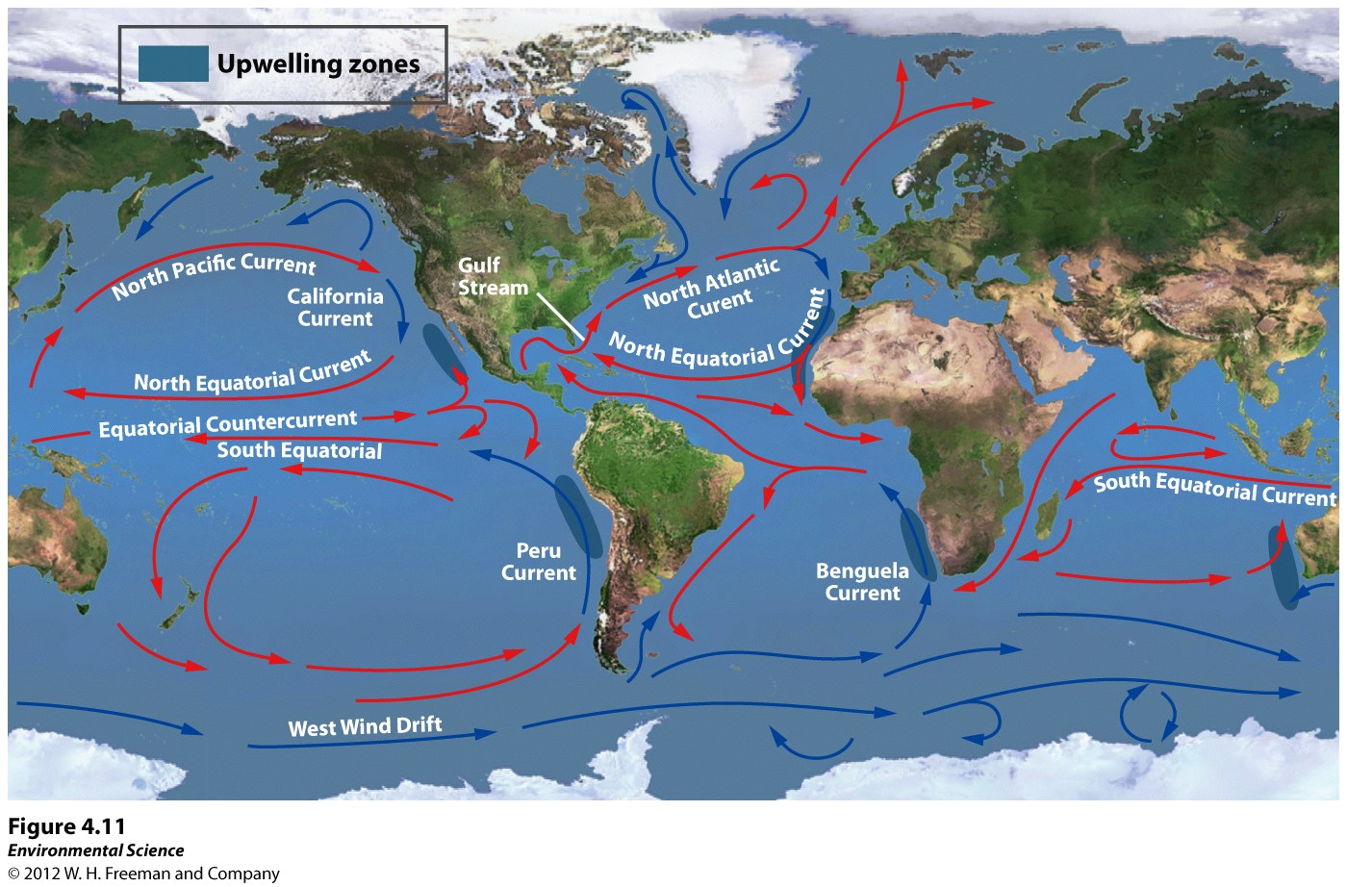

Slide 14
3b. _________ occurs where currents split (usually on the west coast of continents). This rising of cold, nutrient rich water usually is an area of rich ocean life.

Slide 15
3c. Thermohaline Circulation
This circulation is global and is due to __________ as well as _________ differences.
Cold, salty water sinks at higher latitudes and warm, less salty water rises near the equator.
This circulation can take nearly 1,000 years to complete a cycle.
A concern is that melting glaciers could upset the salinity balance and stop the circulation.
Day After Tomorrow
http://www.youtube.com/watch?v=3niR_-Kv4SM

Slide 16
El Nino/La Nina
Normally, currents in the southern Pacific travel from South America to Australia _________.
For reasons not fully understood, those currents __________ every 3-7 years.
The winds and ocean currents change causing the ______________________. This causes less fish along Peru, cooler and wetter conditions in the southeast US, and dry weather in southern Africa and Asia.
http://www.youtube.com/watch?v=7FVZrw7bk1w

Slide 17
El Nino and us
http://www.huffingtonpost.com/2012/09/25/2012-el-nino-developing_n_1912078.html

Slide 18
Rain Shadows
_________________are areas of dryness on the leeward side of a mountain.
______________-facing the wind
______________-back to the wind
Where are some major rain shadows located? How do the biomes on the leeward and windward side compare?

Slide 19
Climatograph
What three pieces of data make up a climatograph?
Fig 4.18, pg 101:
How can you tell what limits plant growth in a biome?
Sketch a representative graph.

Slide 20
Terrestrial Biome Graphic Organizer
Biome
Location
Precipitation (when the most, how much, constant or not, etc)
Temperature (high/low, constant, etc)
Vegetation/Animal Types
Vegetation/Animal Adaptations
Human Interference
Special Notes

Slide 21
Aquatic Biomes
Categorized by salinity, depth, and water flow.
1. Ponds/Lakes:
-freshwater, standing, then with depth zones
-________—shallow edge; most photosynthesis
- ________—open water; floating plants
-________---dark zone; no photosynthesis
-________—muddy bottom

Slide 22
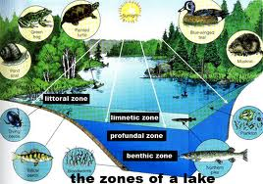

Slide 23
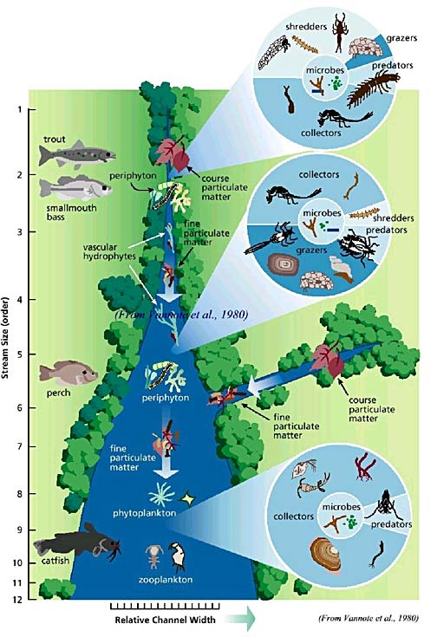
Streams/Rivers:
-freshwater, flowing, depth can vary
-water speed determines the life in the water
How would the life differ by speed?

Slide 24
Wetlands:
-extremely high productivity
-filters water
-prevent floods
-habitat for migrating birds
Freshwater: submerged part or all of year but shallow enough to support specialized plants
- _______ have trees
-_______ are dominated by grass
-_______bogs are usually acidic

Slide 25
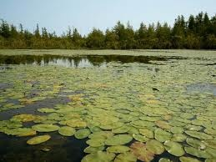
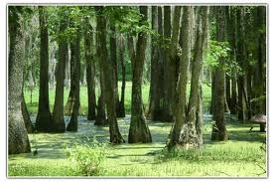
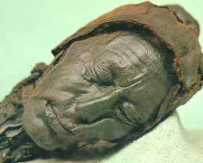
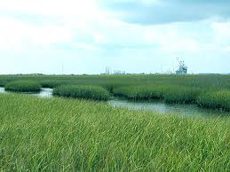

Slide 26
___________:
-along coasts; usually in an ________where river empties to ocean; high in nutrients
____________:
-tropical and subtropical coasts; protect from erosion
Coral Reefs:
-mutualistic relationship between _________ and __________
-dying because ocean level is rising and algae can’t photosynthesize; b/c pH is rising; b/c pollution and sedimentation

Slide 27
____________:
-between low and high tide
-special adaptations to survive in and out of water
Ocean:
-intertidal zone
-photic zone- light can reach
-aphotic zone- no light; food webs depend on detritus from above or chemosynthesis around smokers
http://www.youtube.com/watch?v=5JzUgi6YNlY

Slide 28
Health of aquatic biomes
Water quality tests
-DO -turbidity
-temp
-carbon dioxide
2. Macroinvertebrates
-species have different range of tolerance for pollution and can be indicator species
-many are larvae of insects
Maroon Lagoon water test

Slide 29
Macroinvertebrate sampling
Macroinvertebrate sampling:
http://www.youtube.com/watch?v=IuNn4VqFtJI

